Slide 1
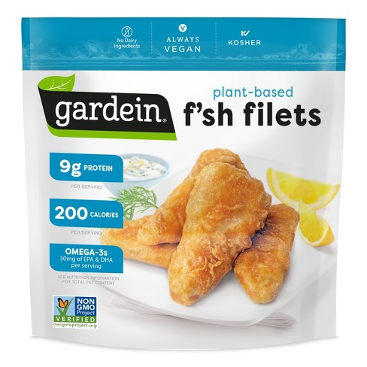
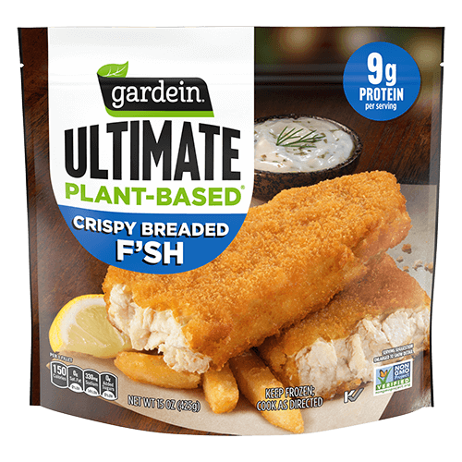
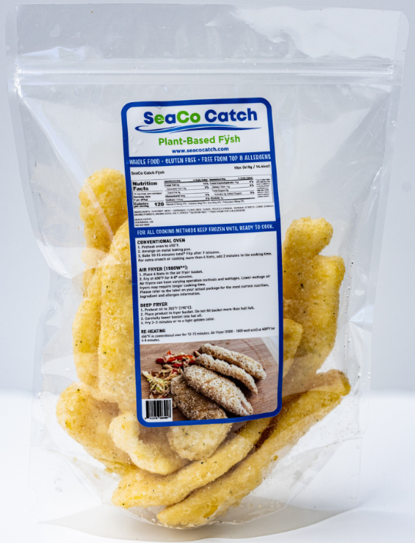
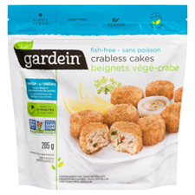
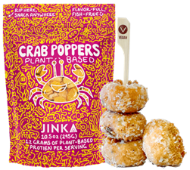
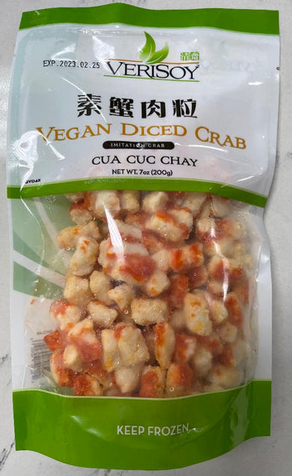
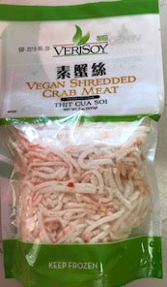
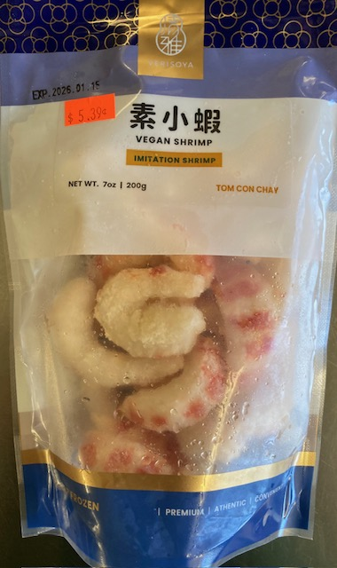
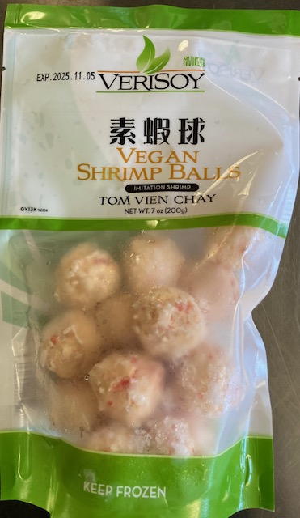
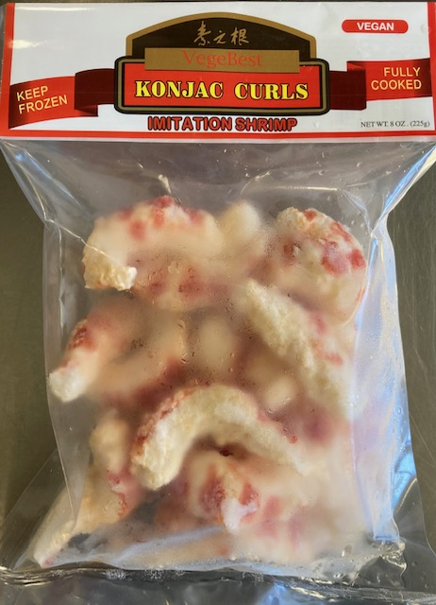
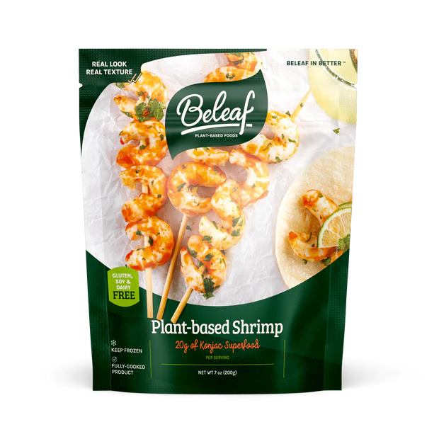
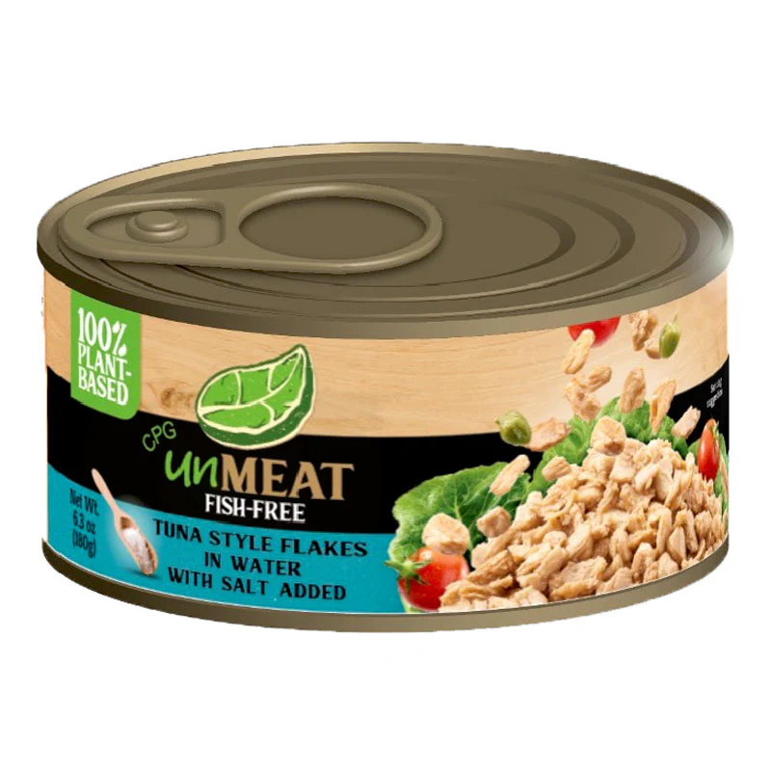
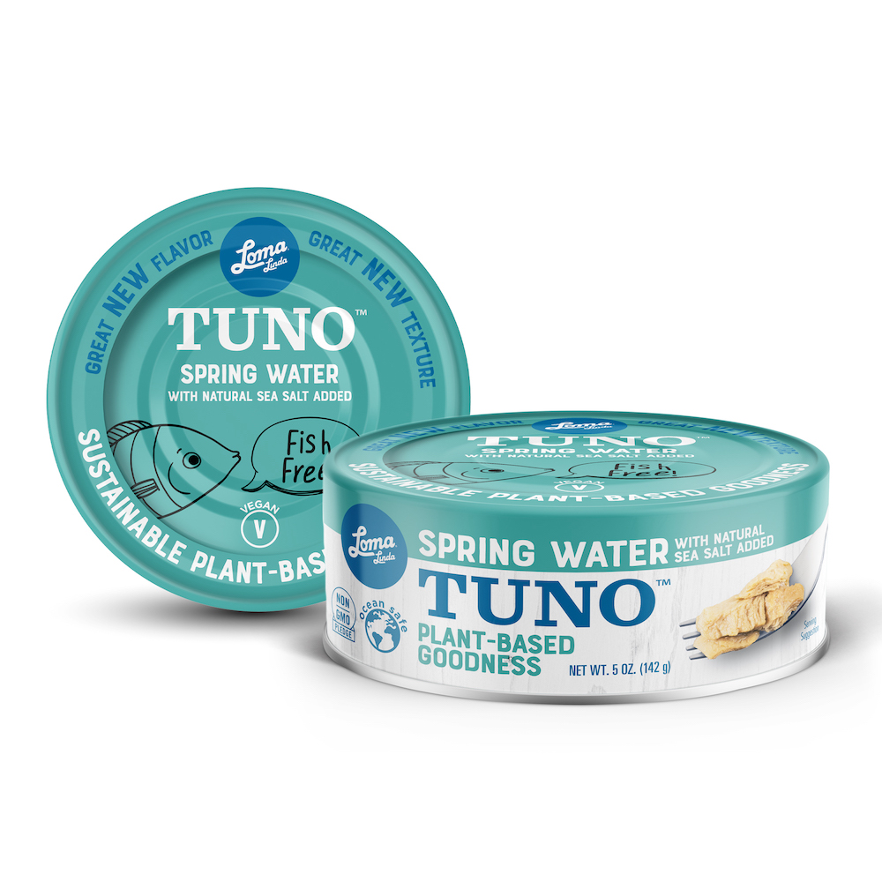
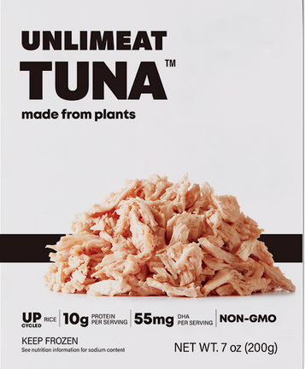
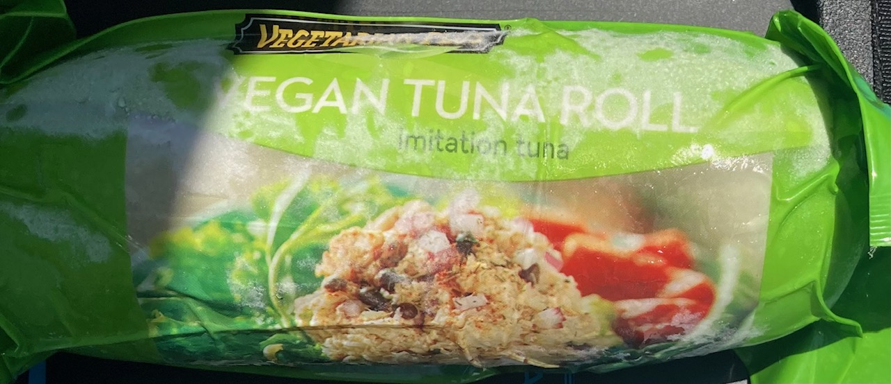
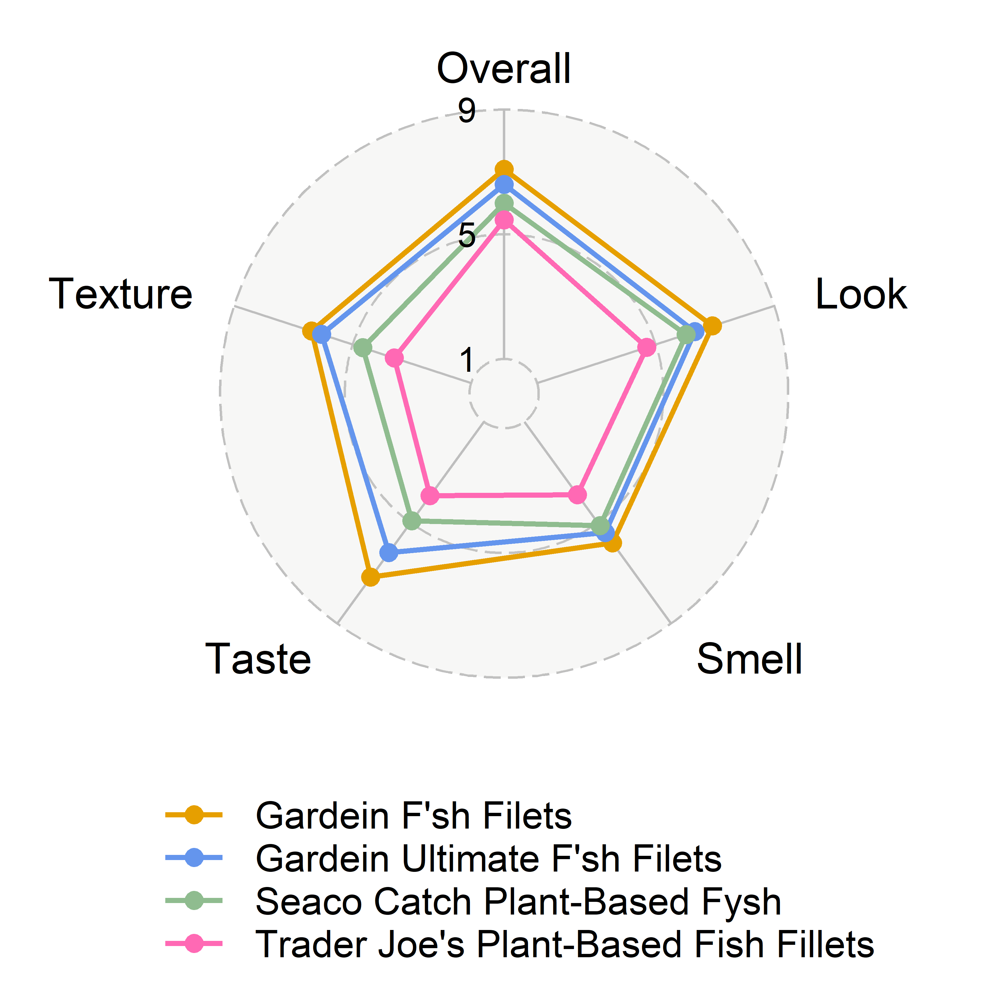
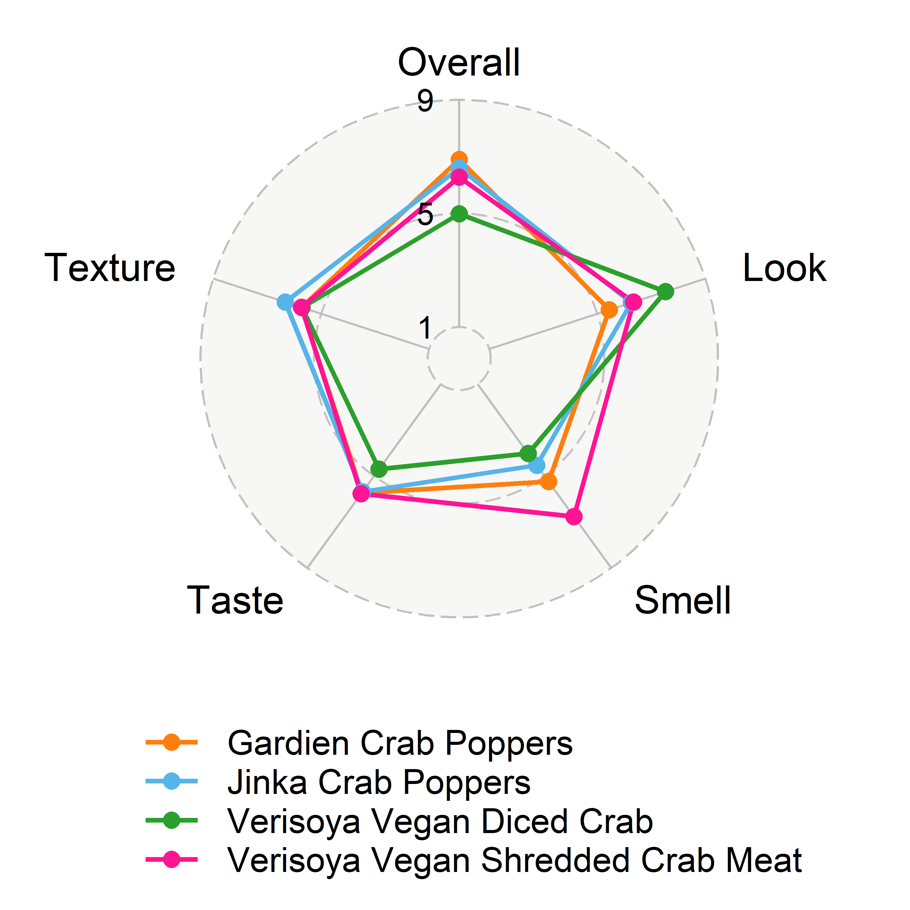
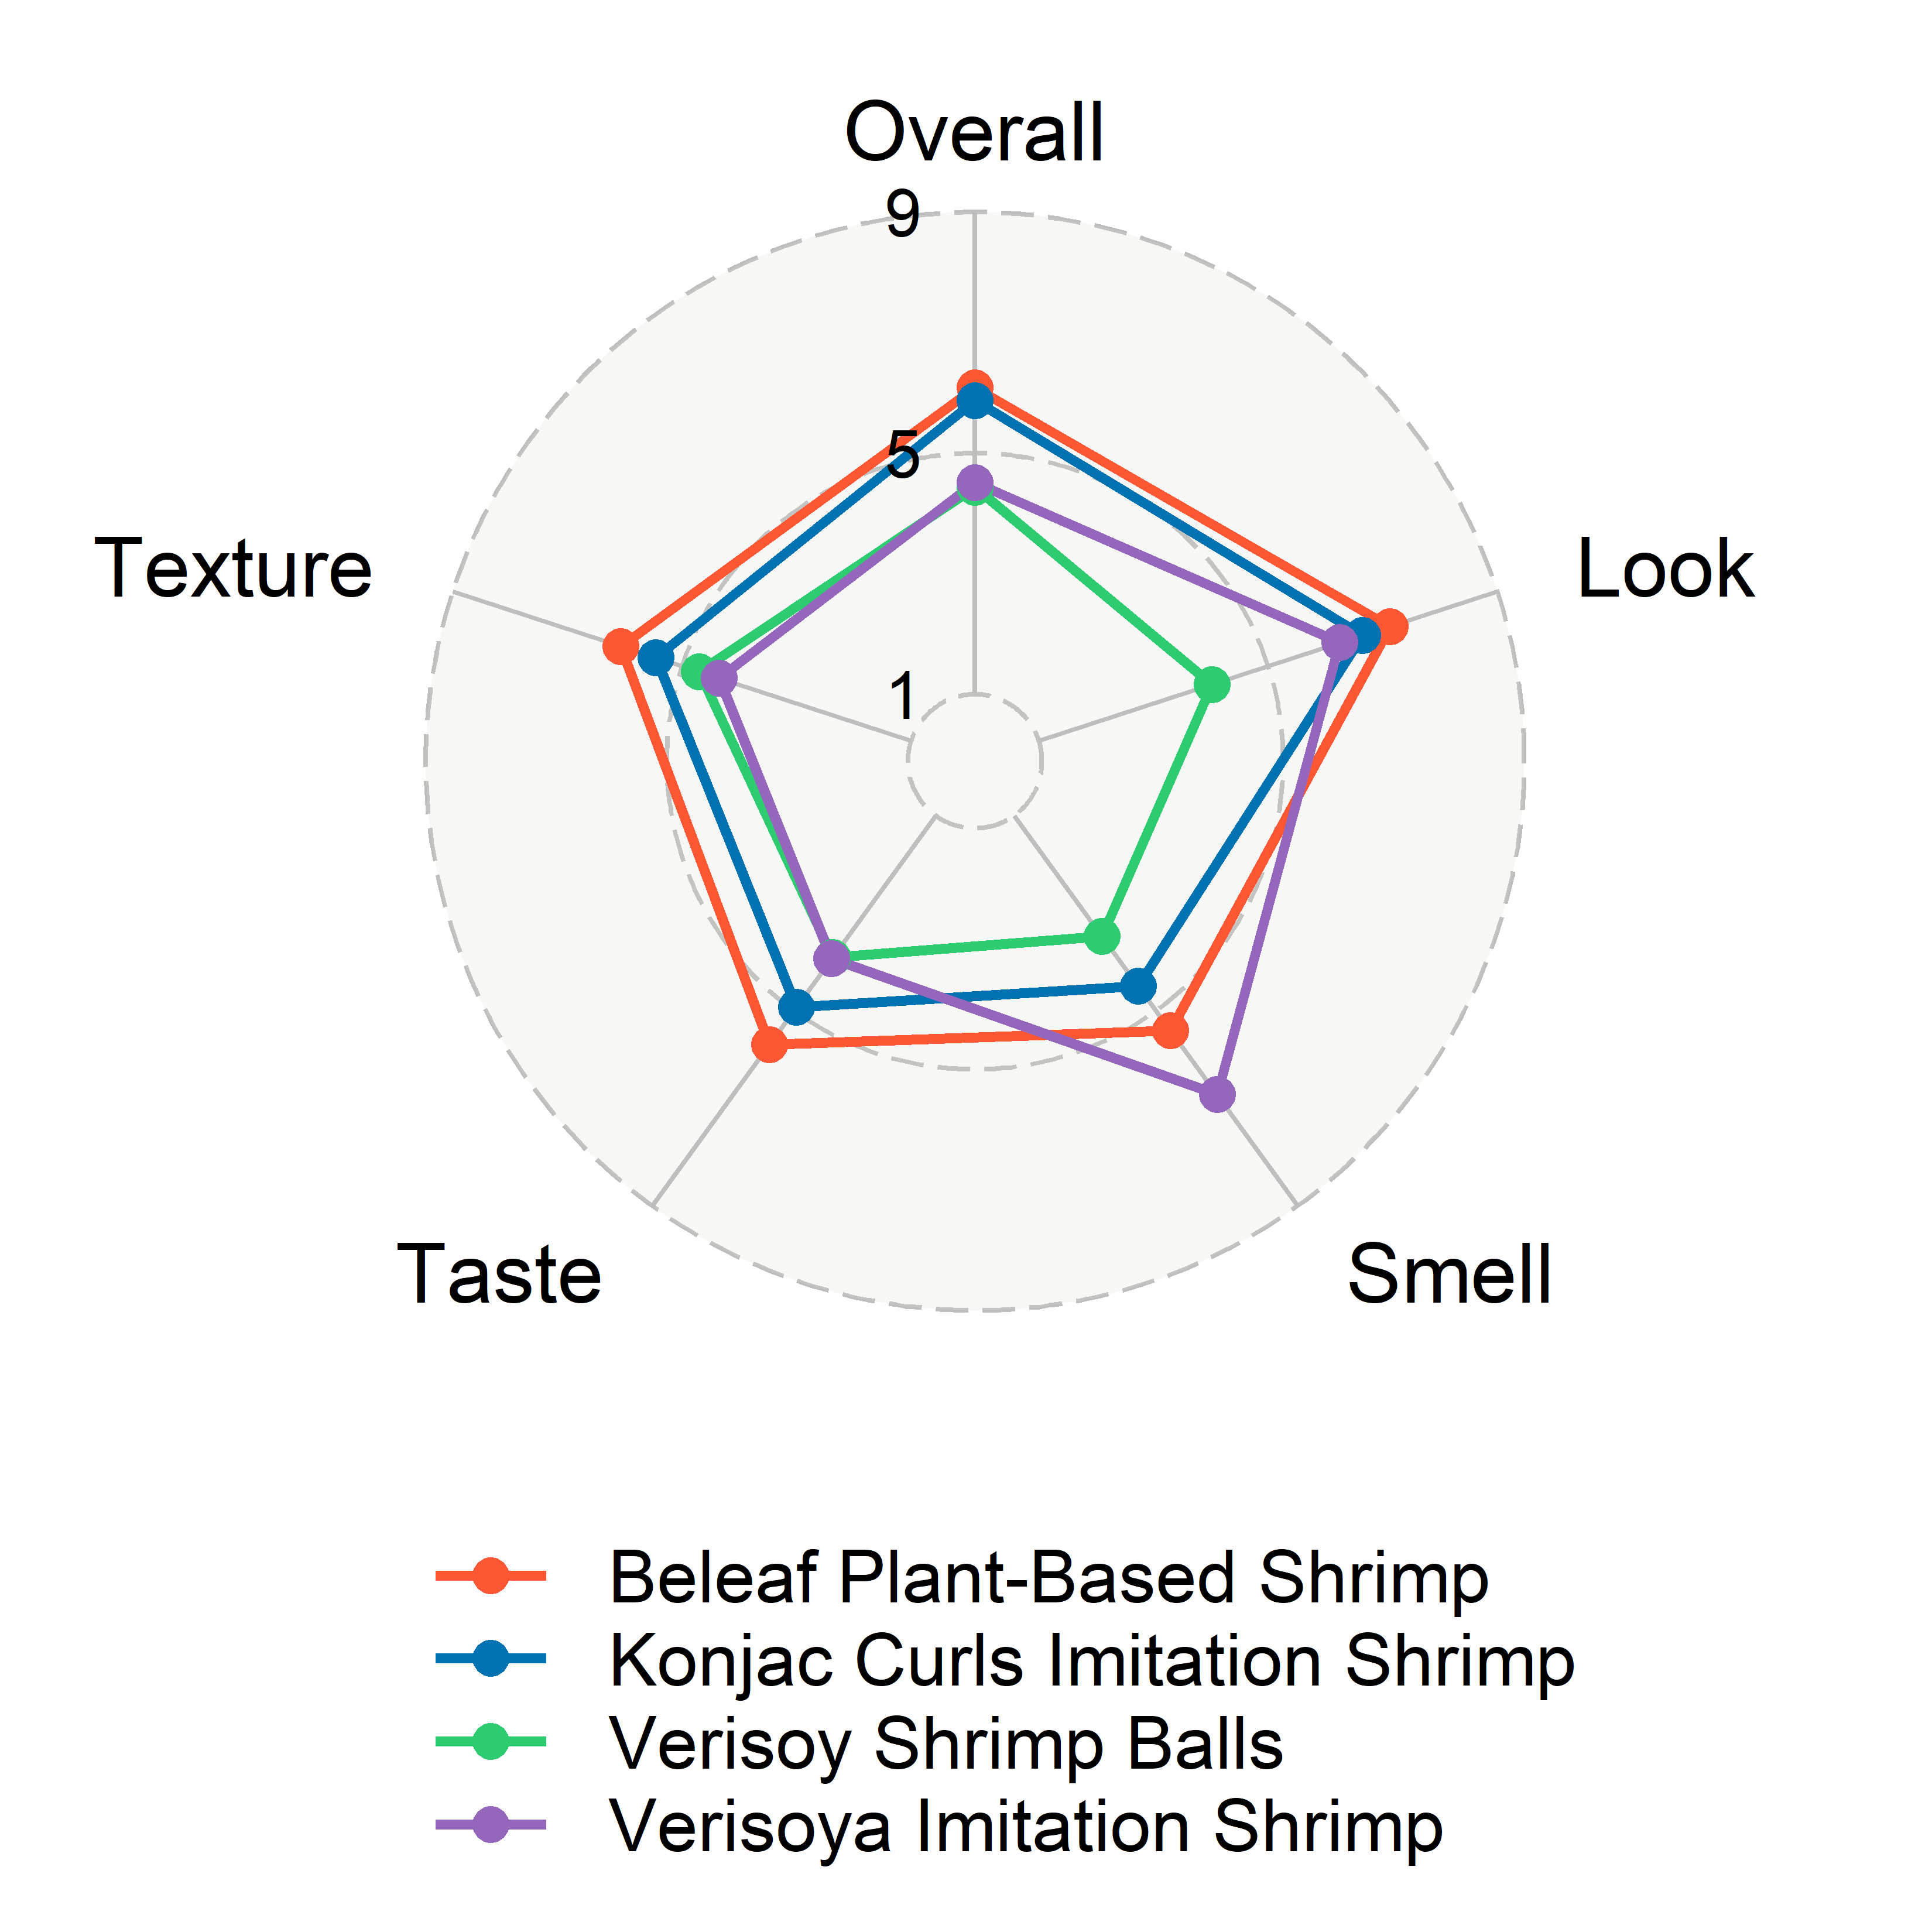
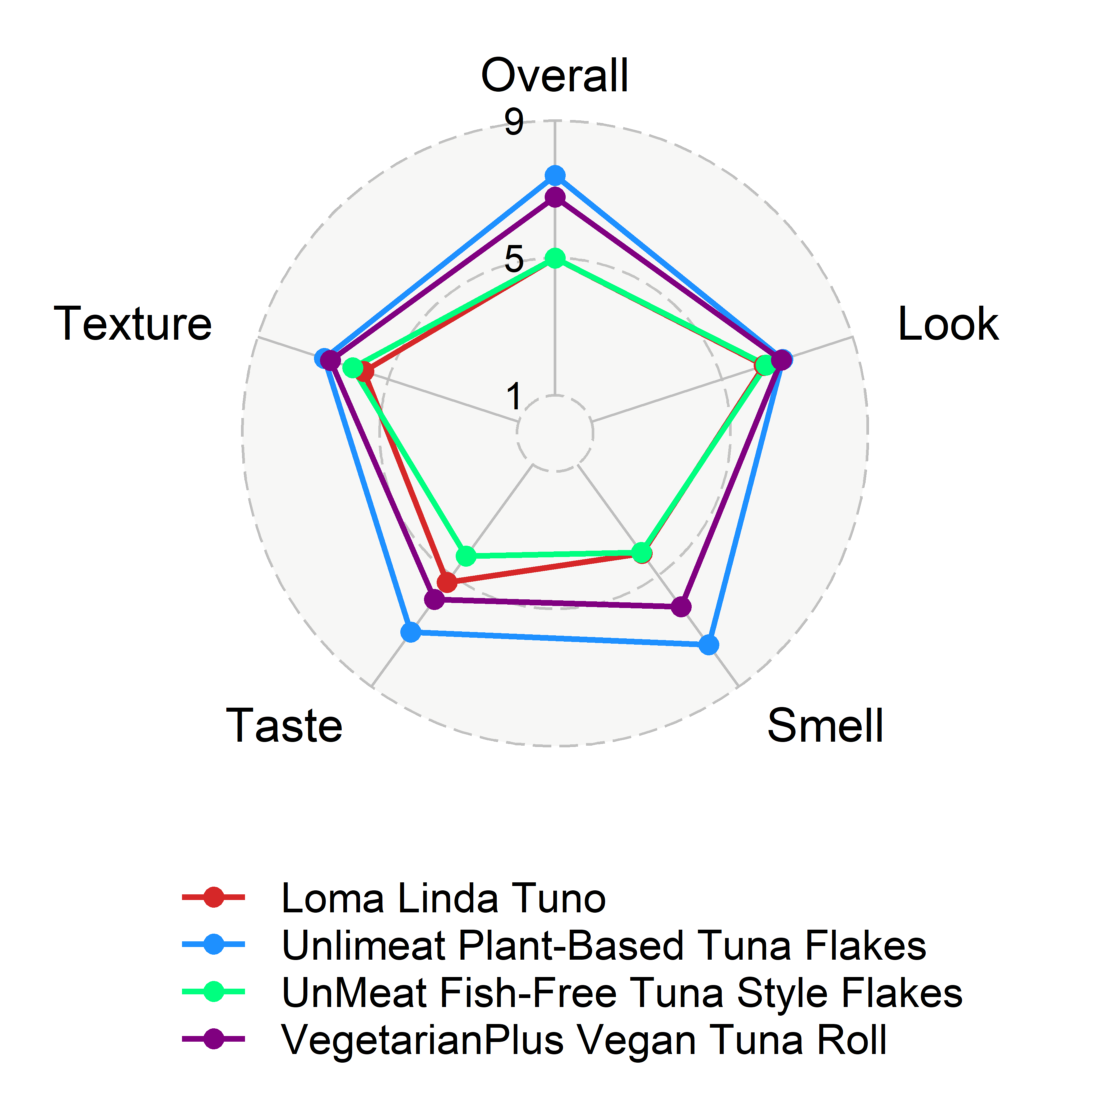
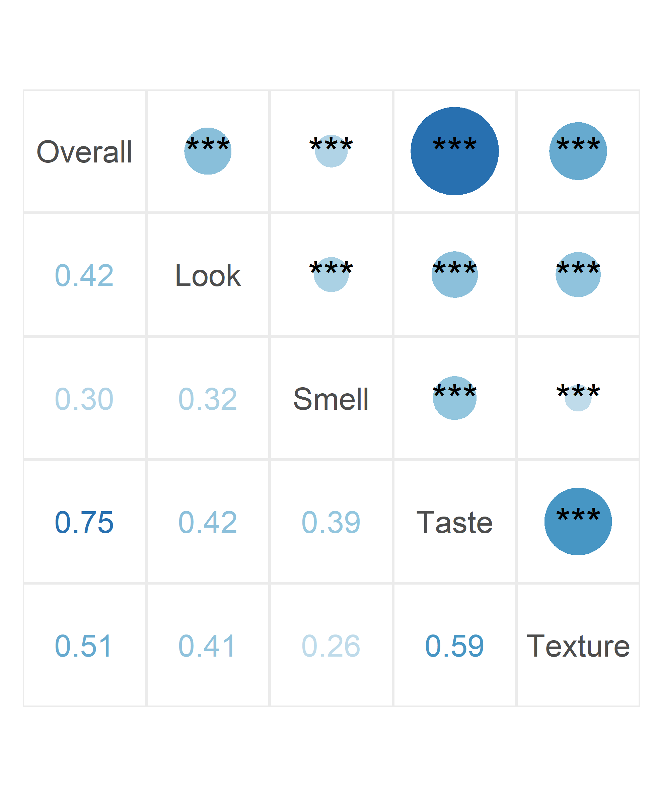
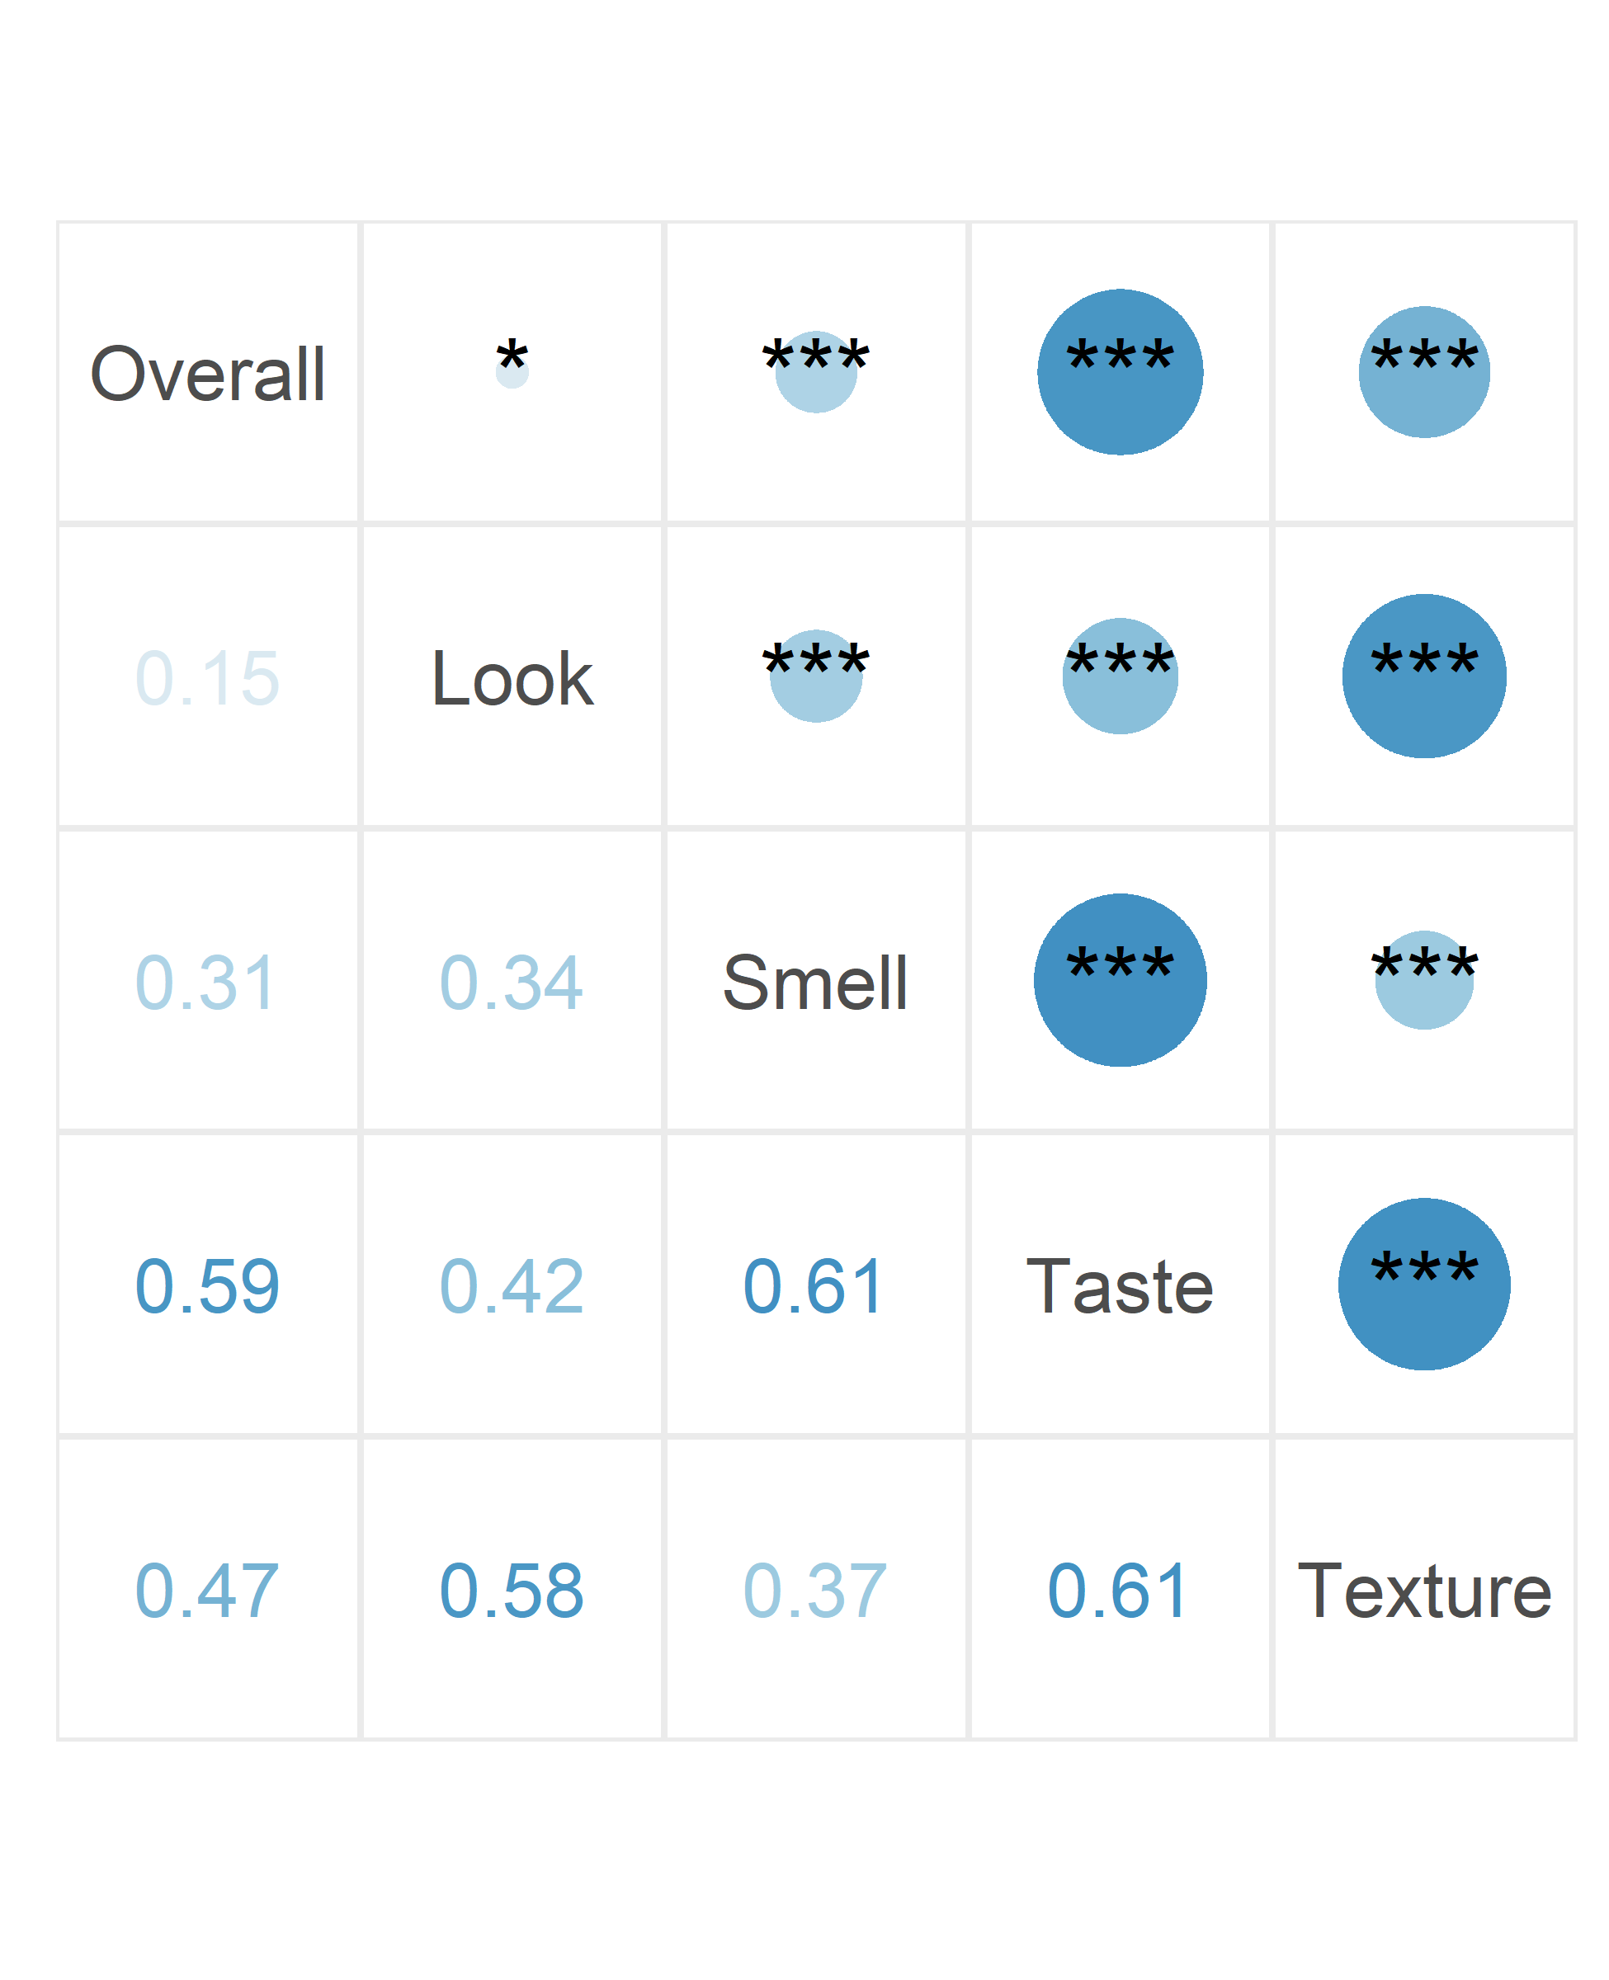
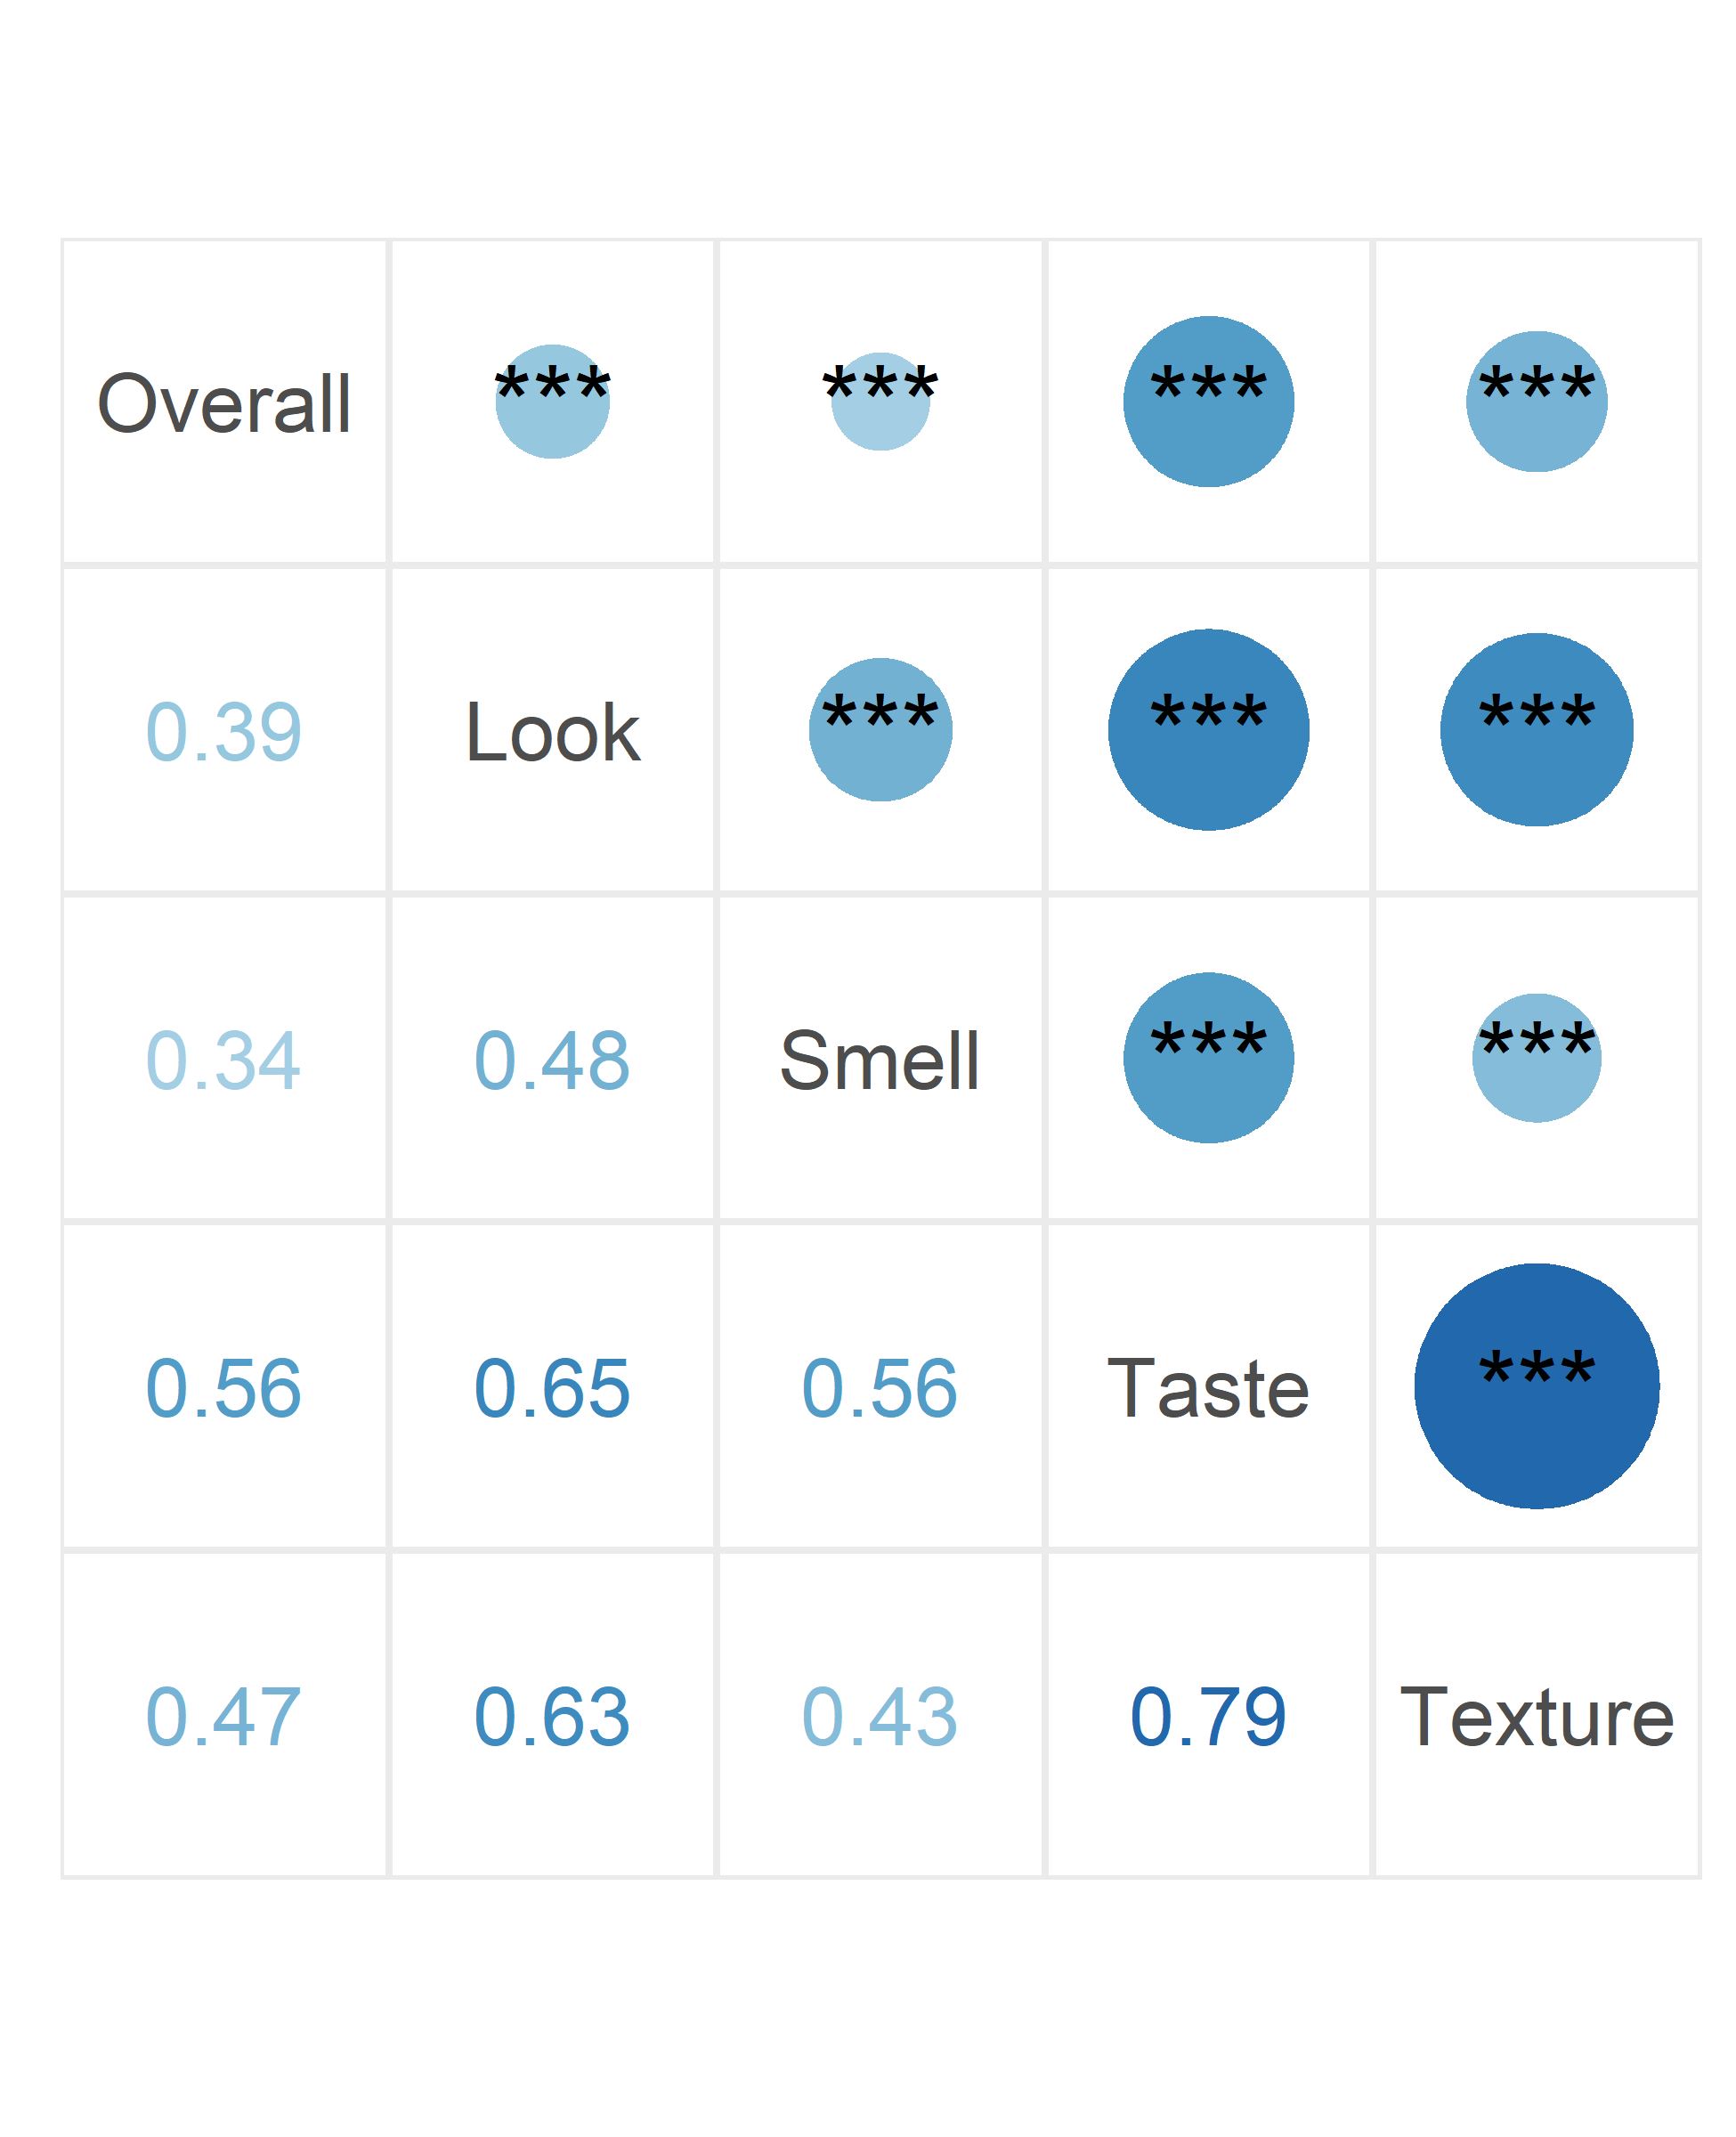
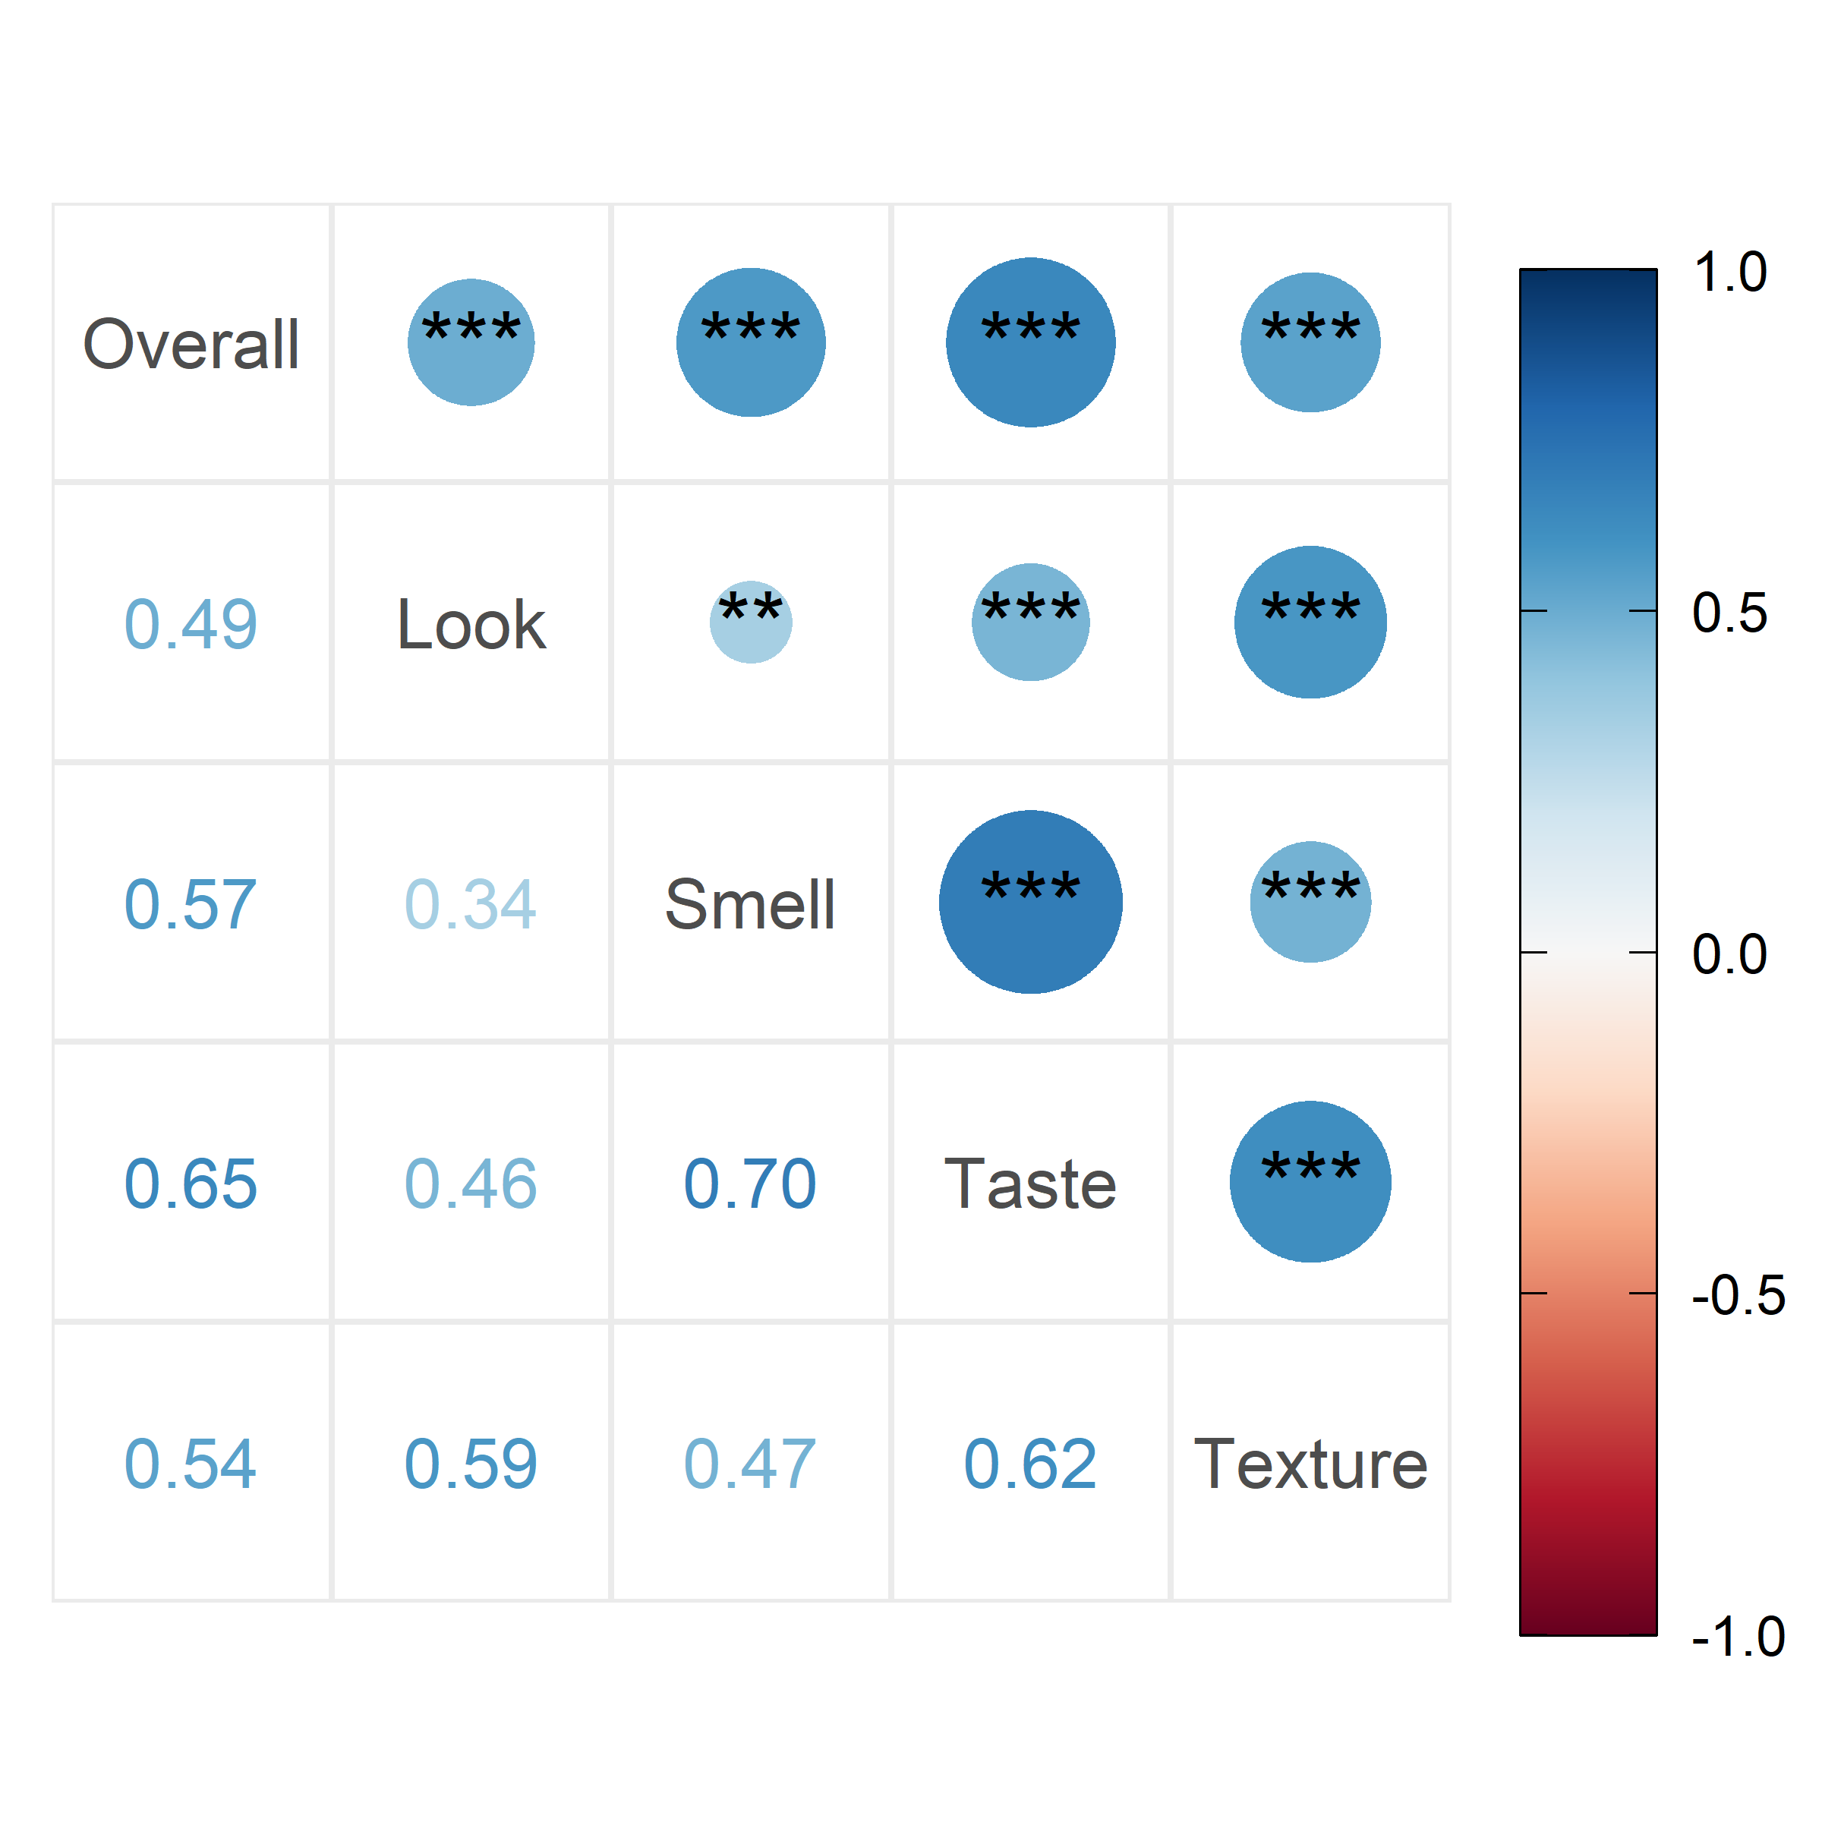
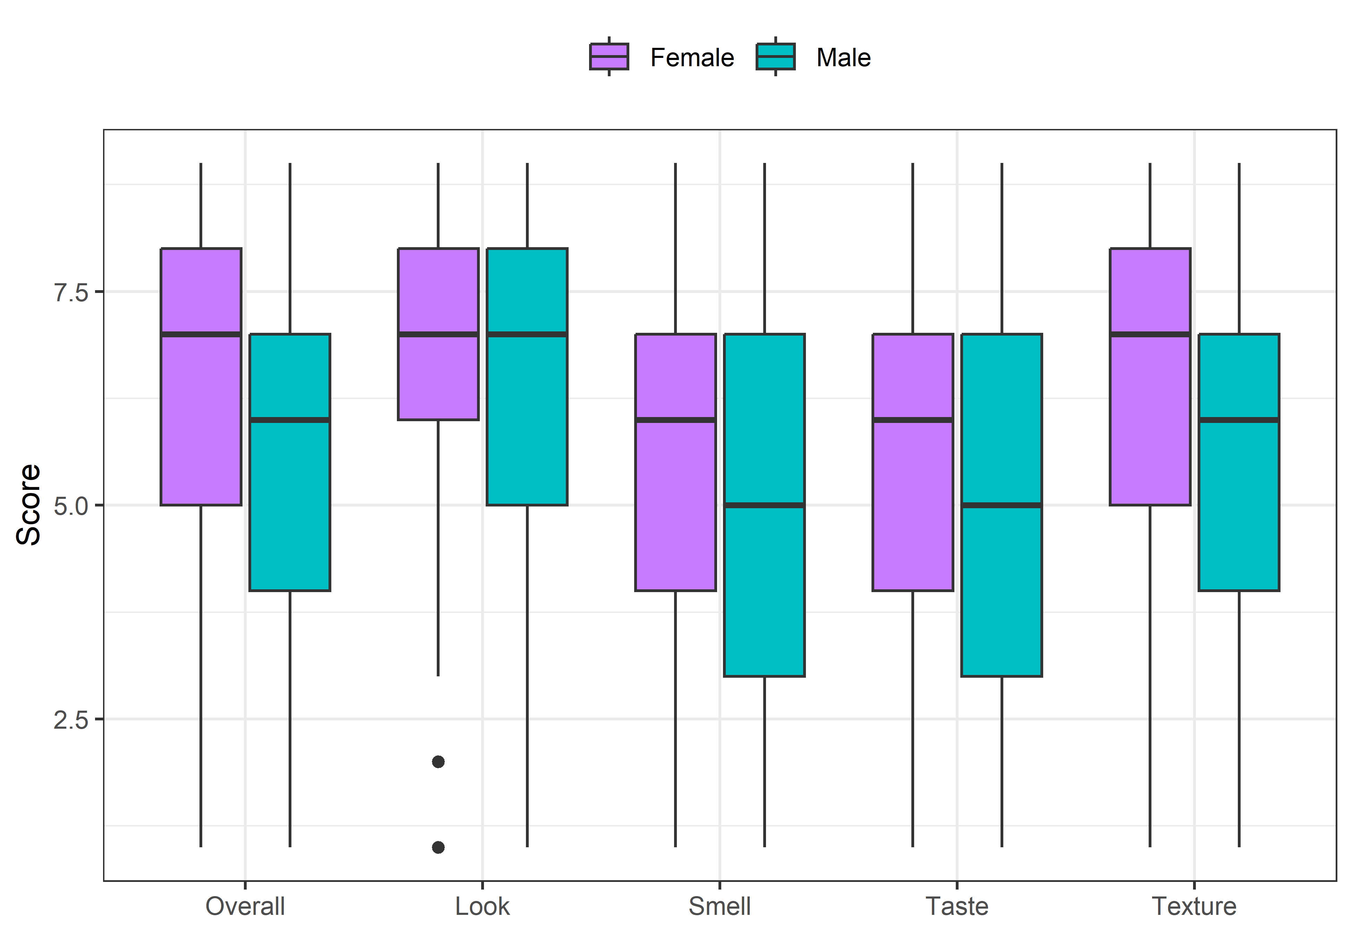
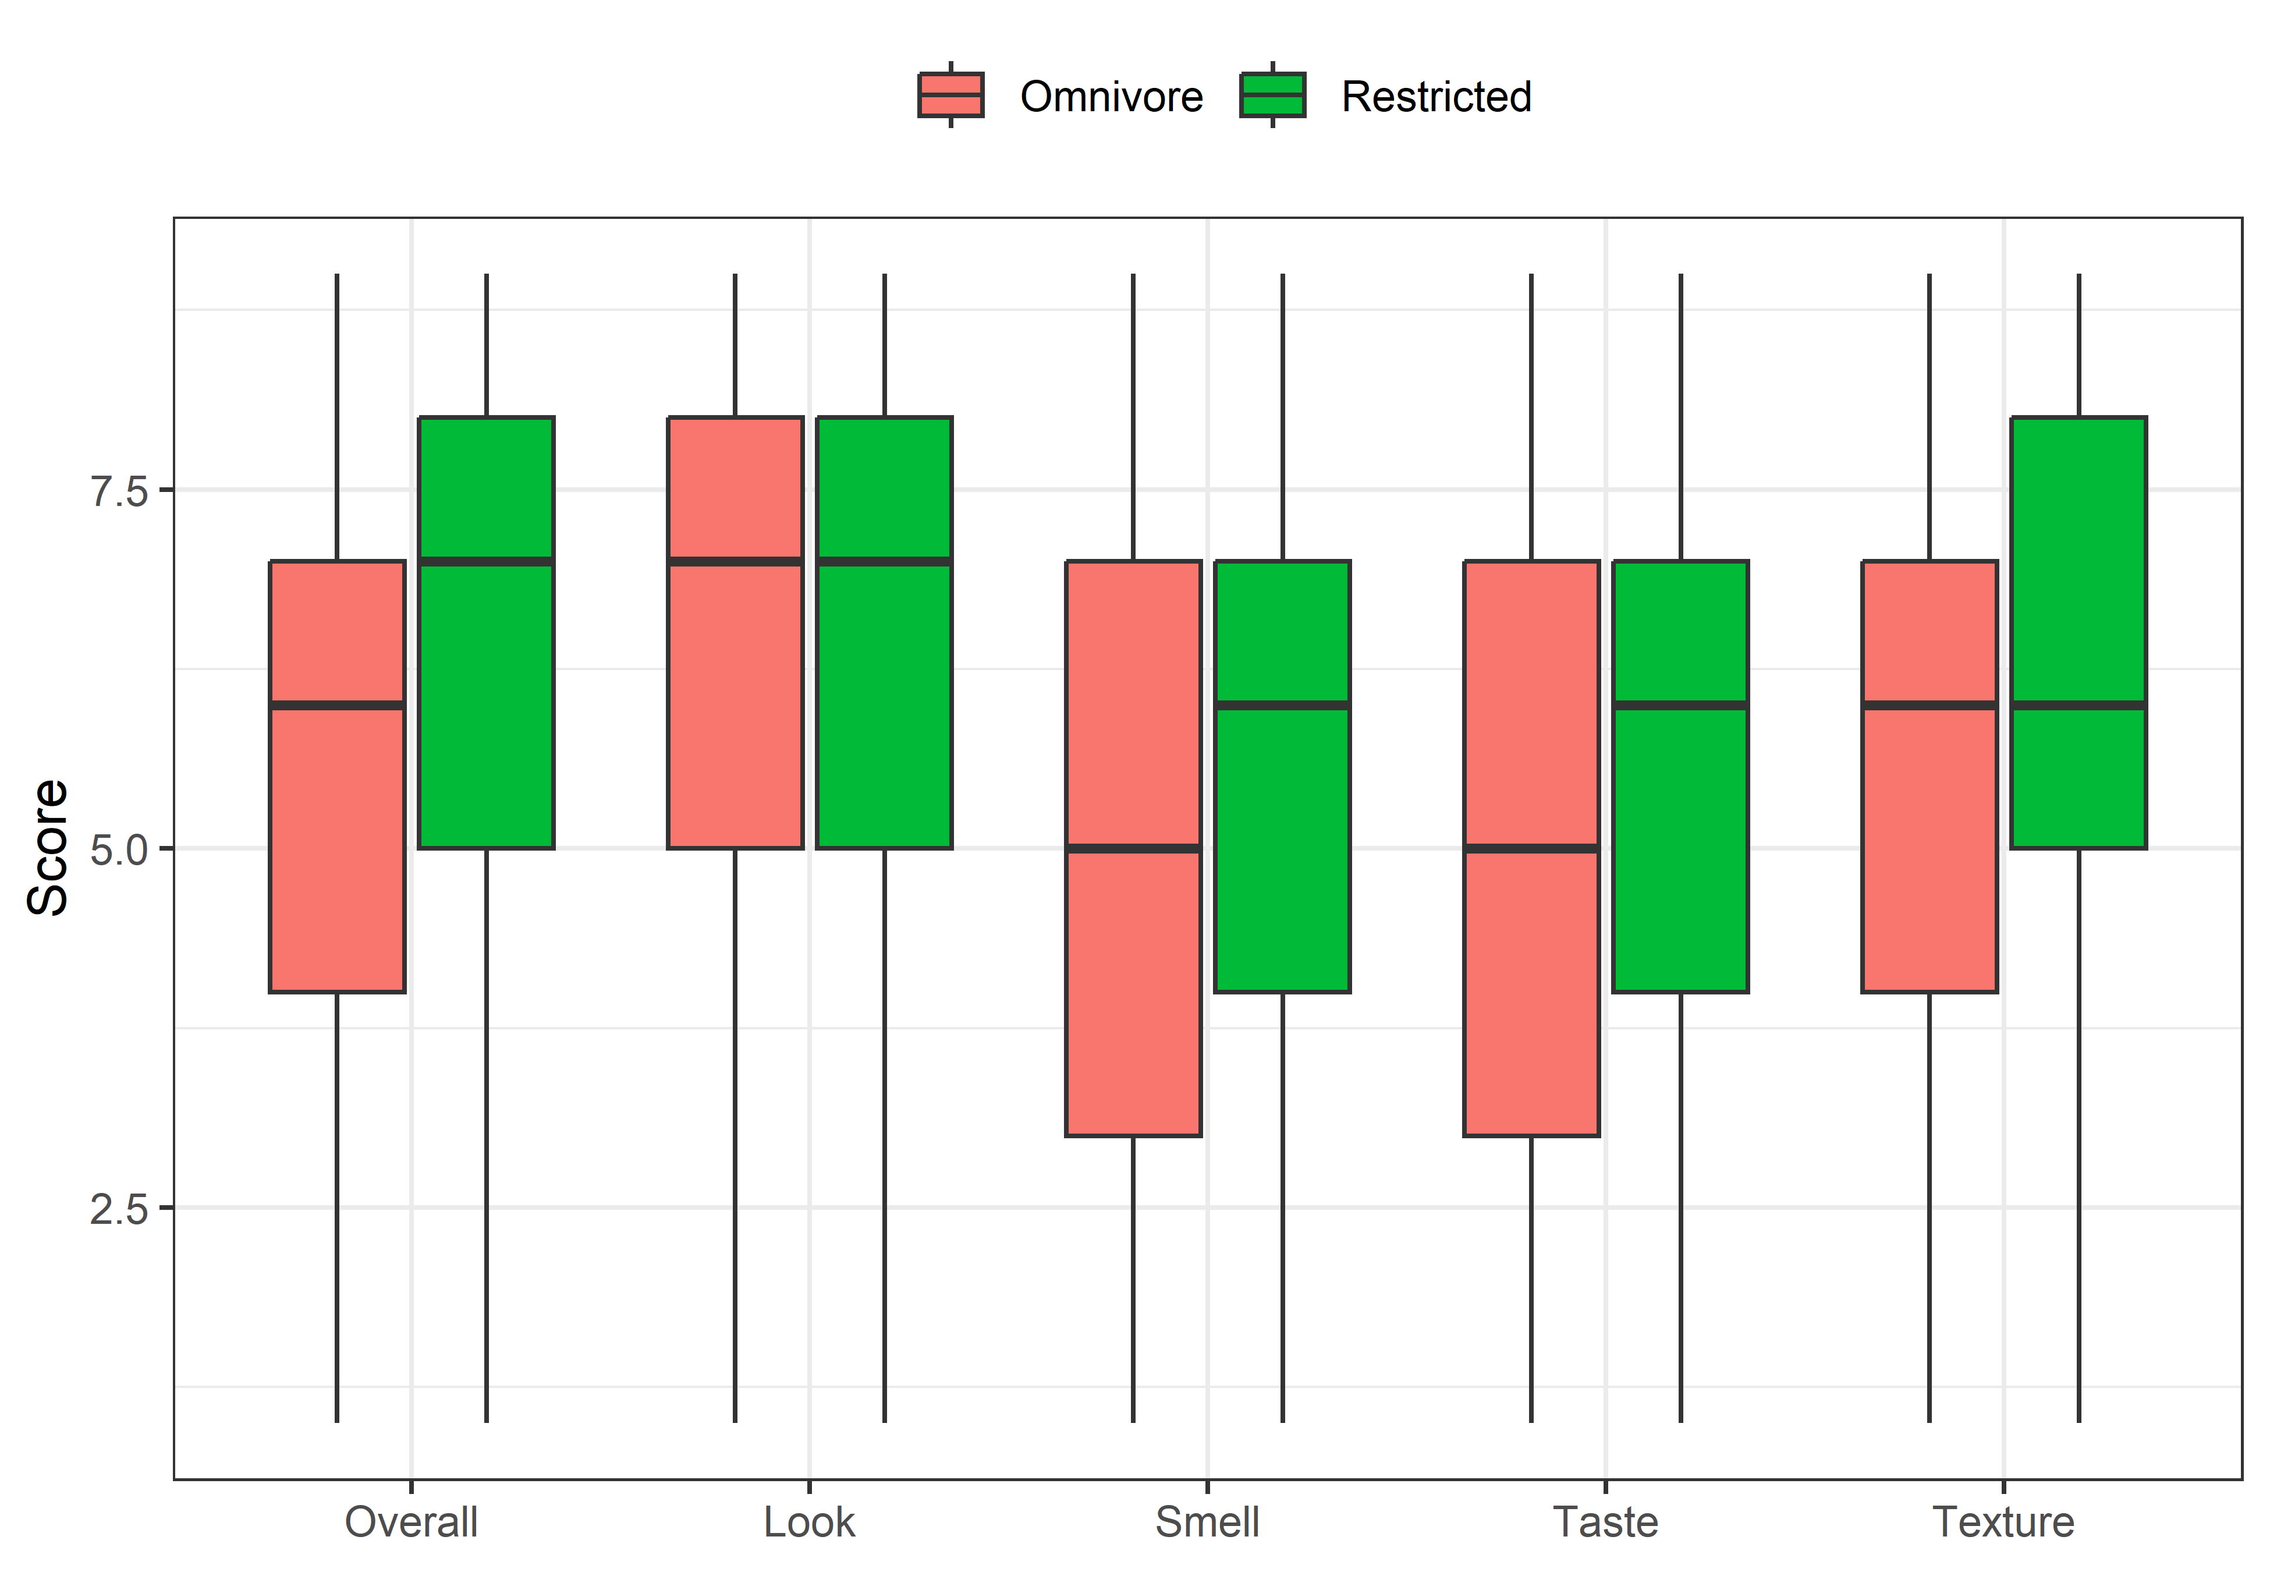
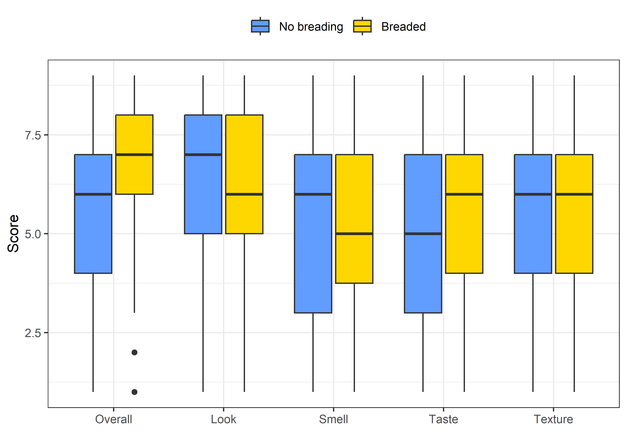
Sensory Similarity and Consumer Preferences
of Plant-Based/Vegan Seafood Analogues
James Wadman, RDN¹, Liana Feng¹, Stacey Lehrer¹, Ali Raza, PhD¹, Jing Zhao, PhD^{1,2}, Changqi Liu, PhD^{1,2,*}
¹School of Exercise and Nutritional Sciences, ²Center for Better Food Futures, San Diego State University
Introduction
Results
There are health, environmental, and ethical reasons driving a global shift toward a more plant-based diet. This trend includes increased consumption of animal protein substitutes. Internationally, seafood is an important subset of these foods being replaced. As the demand for plant-based seafood analogues grows, understanding consumer preferences and the sensory properties of these products becomes increasingly important. Ensuring that these alternatives are highly acceptable to consumers is essential for the success of the industry. Examining key aspects contributing to consumer acceptance and how accurately these products replicate traditional seafood will further enhance their market potential.
Cod
Crab
Shrimp
Tuna
A,AB,BC,C
A,A,B,A
A,A,B,B
B,A,B,A
A,A,B,C
A,A,A,B
B,B,A,B
A,AB,B,B
A,A,B,A
Objective
A,B,C,D
A,A,A,B
A,A,B,A
B,BC,C,A
A,AB,B,B
B,BC,C,A
B,A,B,AB
C,A,C,B
This study aimed to evaluate the sensory attributes and overall liking of seafood analogues among participants with varied dietary preferences. The results of this study will inform which products may be used for best-practices guidance in future manufacturing.
Methodology
Figure 1. Spider chart of sensory characteristics of vegan seafood analogues.
Participants evaluated imitation shrimp, cod, tuna, and crab products, with four representative products selected for each seafood. The main inclusion criteria was that participants had previously consumed the corresponding animal seafood product and felt confident in recognizing its characteristics. Participants rated the overall liking of commercially available seafood analogue products and their similarity to real seafood in terms of appearance, smell, taste, and texture.
Results
A total of 182 participants (76% omnivores) evaluated at least one type of seafood analogue. Overall liking of the products positively correlated with similarity to real seafood in appearance, smell, taste, and texture, with taste showing the strongest correlation. Tuna analogues garnered the greatest acceptance, with Unlimeat brand standing out as the favorite in that category.
Figure 2. Correlation matrix of sensory characteristics of vegan seafood analogues.
Conclusion
P = 0.040
P = 0.039
P = 0.033
P = 0.001
P < 0.001
P < 0.001
P = 0.006
P = 0.006
P = 0.007
P < 0.001
P = 0.003
P < 0.001
This study highlights the positive correlations between the sensory similarities and overall liking of seafood analogue products, with preference differences between omnivores and those on restricted diets. It sets the stage for further analysis of key flavor compounds in seafood analogues using gas chromatography-mass spectrometry-olfactometry.
Acknowledgement
This project is supported by the Good Food Institute, the HSI (2022-77040-37620) and NEXTGEN programs (2023-70440-40156) from the USDA National Institute of Food and Agriculture (NIFA), the Student Research grant from the School of Exercise and Nutritional Sciences, and the Faculty-Student Mentoring Program from the San Diego State University.
Figure 3. Gender differences in rating sensory characteristics of vegan seafood analogues.
Figure 4. Differences in sensory characteristic ratings of vegan seafood analogues between omnivores and people with dietary restrictions.
Figure 5. Differences in sensory characteristic ratings between breaded and non-breaded vegan seafood analogues.

